Slide 1
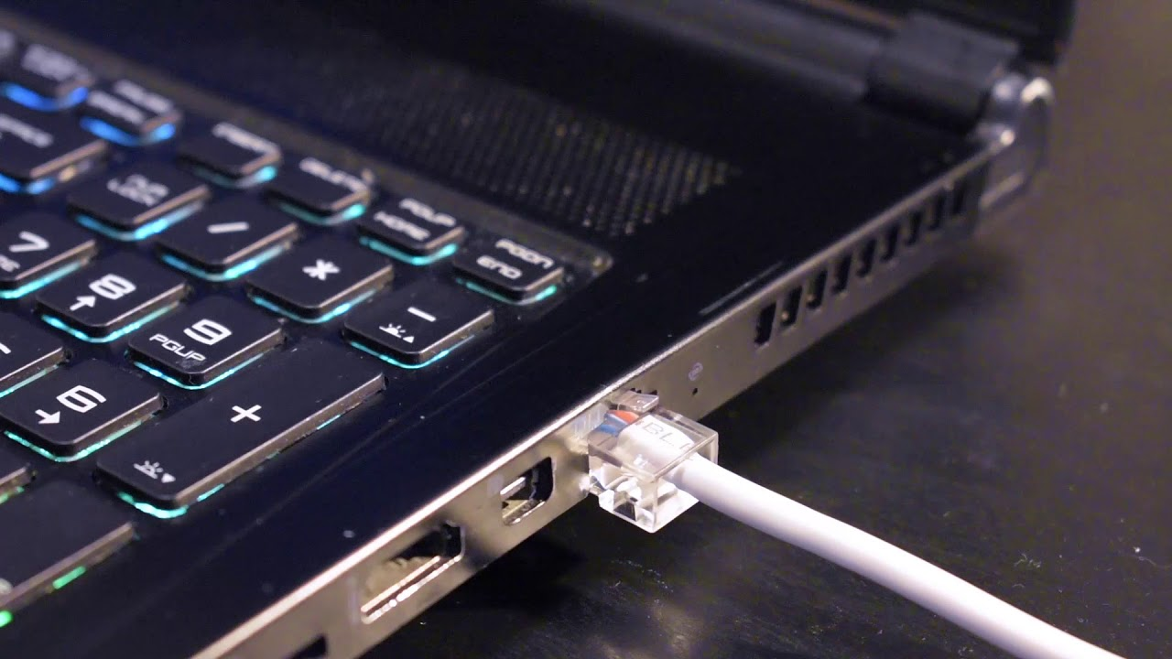
Cx1106
Computer Organization and Architecture
Comms and UI - Questions

Slide 2
Which pin does USB Host/Hub supply power to the USB devices?
Data+
Data-
VBUS
Ground
The very basic USB interface consist of 4 pins: VBUS, Ground, Data+ and Data-.
Data+ and Data- is used for the actual data transmission. As the signal name implies, the USB interface uses differential signalling.
USB devices can be power by the USB connection, this is done by the Host/Hub supplying a +5V via the VBUS pin to the USB devices.

Slide 3
How does the USB Host know what USB device is connected at its port?
Information is pre-fixed before connecting
It enumerates the USB device by polling the logic states of the ID pins on the device
There is a handshaking process after connection where the USB Host and device will exchange information to let the other party knows of capability and requirement.
Host and device exchange ID during enumeration to understand each other’s capability and requirement
When a USB device is connected to the USB Host, a handshaking procedure known as USB Enumeration will be initiated.
During this procedure, the host and device will exchange information regarding its requirement capability to each other so that a decision can be made as to whether they are compatible.
Once the host determine that it is able to support the USB device, it will proceed with more connection procedure such as loading the appropriate USB device drivers.

Slide 4
Why is it that many wireless standards chose to use 2.4GHz as its operating frequency?
It was used in the first version of Wifi and developers continued to used that since the characteristics of that frequency range has been well researched and understood.
The frequency range is free for use world wide.
Transmission range of this frequency is one of the best among the various frequency range available for use by consumers.
It’s the resonance frequency of water, which is available in abundance in nature.
Essentially, 2.4Ghz is used in many wireless appliance because it belongs to a group of RF bandwidth known as the International Scientific Medical (ISM) band. And usage of this RF band is free, i.e. no licensing fee has to be paid.
This compares with other RF bandwidth such the 3G, 4G cellular band which the telcos such as Singtel, Starhub, M1, TPG etc typically paid huge licensing fees to the authority in order to be able to operate in that band.

Slide 5
Which of the following factor does not affect wireless transmission range?
Transmission Power
Transmission Frequency
Interference from other wireless sources
Number of repetitions in transmission
[A] Larger transmission power => longer range
[B] Higher frequency => higher attenuation => shorter range
[C] Increase in interference => short range
[D] Number of repetition in transmission may increase the reliability of transmission but will not increase the transmission range

Slide 6
Which of the following would not be able to mitigate wireless interference?
Select different Wifi Channels
Use frequency hopping
Increase Transmission power
Place various wireless devices near each other so that it’ll be in the transmission signal shadows of each other
Placing various wireless devices near each other will increase the external interference instead of reducing the interference. The transmission characteristics of these sources are likely different from each other so chances of them cancelling out each other is very slim compared to the potential interference they will generate for each other.

Slide 7
What is the basic operating principle of the capacitive touch screen?
Magnetic object interacting with the electric field generated by the screen, affecting the system’s capacitance
Electrical conductive object interacting with the electric field of the system setup, affecting the system’s capacitance.
Pressure from the object touching the screen changes the capacitance of the system
Obstruction of light from opaque objects affecting the capacitance of the light sensitive setup of the screen.
Capacitive touch system operate on the principle of change in system capacitance brought about by introduction of an electrically conductive object into the electrical field of an existing system.
[A], [C] and [D] talks about other forms of real world signals or other object property.

Slide 8
Which of the following is not a function of the Camera Module in a phone?
Focus image object
Interfacing to Host Processor
H264 Video Compression
Conditioning of captured image
Most smartphone camera these days include all the above functionality.
The only one that might not be included is the H264 Video Compression, but even that is becoming a common feature in the ISP of the camera module.
Advantages of doing the video compression in the ISP instead of the phone’s application processor is that this is a very standard process and come easily of designed into a processor/logics specialised in video compression. Power consumption of such implementation is typically lower than software-based implementation in the phone’s application processor.

